Slide 1
Chapter 15 Eigenvalues and Eigenvectors
By
Hyung Jae (Chris) Chang
Troy University

Slide 2

Introduction
Eigen?
“proper”, “characteristic”
Where is it used?
Find natural frequencies and mode shapes in dynamics systems
Solving differential equations
Reducing dimensions using principal component analysis
Obtaining principal stresses in mechanics
Google search engine algorithm →PageRank

Slide 3

Eigenvalues and Eigenvectors
Matrix A applied to a column vector x → Ax which is a linear transformation of x.
A special transform → Ax = $λx$ where A is an n x n matrix, x is an n x 1 column vector (x ≠ 0) and $λ$ is a scalar.
$λ$ is an eigenvalue of the matrix A.
The associated vector x is called an eigenvector corresponding to $λ$.

Slide 4

Motivation of Eigenvalues and Eigenvectors
Understand the characteristics of the linear transformation
Help us simplify the solution to our problem.
Assume that we have Ax where A and x are two vectors. This means some kind of transformation of the vector x into another vector.
For some vectors, the effect of the transformation, Ax, is only scaling (stretching, compressing and flipping).
The eigenvectors are the vectors having this property and the eigenvalues $λ$ are the scale factors.

Slide 5
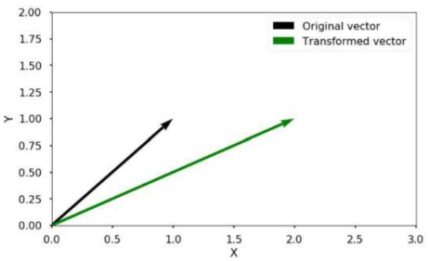
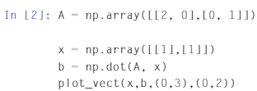
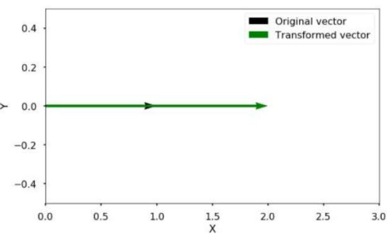
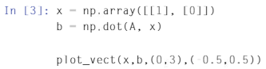
Motivation of Eigenvalues and Eigenvectors (cont.)
Examples

Slide 6

Characteristic Equations
From $Ax= λx$
Change the form to $(A−λI) x=0$
I is an identity matrix with the same dimension as A
If $(A−λI)$ has an inverse matrix ${(A−λI)}^{−1}$
$x=0$
If $(A−λI)$ doesn’t have an inverse matrix ${(A−λI)}^{−1}$ → singular (no inverse) which means that the determinant is zero.
$det(A−λI) =0$ → this equation is called a characteristic equation used for getting eigenvalues

Slide 7

Characteristic Equations (cont.)
Obtain the eigenvalues for matrix [[0,2],[2,3]] → ($\left|\begin{matrix}0 & 2 \\ 2 & 3\end{matrix}\right|$)
characteristic equation produces $\left|\begin{matrix}0 & 2 \\ 2 & 3\end{matrix}\right|−\left|\begin{matrix}λ & 0 \\ 0 & λ\end{matrix}\right|= \left|\begin{matrix}0−λ & 2 \\ 2 & 3−λ\end{matrix}\right|\text{= 0}$
$ad−bc→−λ\left(3−λ\right)−2×2=λ^{2}−3λ−4= (λ−4)(λ+1)$
Two eigenvalues $λ=4,λ=−1$

Slide 8

Characteristic Equations (cont.)
Eigenvectors for $λ=4,λ=−1$?
$λ=4$→ plugged in back to $\left(A−λI\right)x=0$
$$\left[\begin{matrix}−4 & 2 \\ 2 & −1\end{matrix}\right]\left[\begin{matrix}x_{1} \\ x_{2}\end{matrix}\right]=\left[\begin{matrix}0 \\ 0\end{matrix}\right] →−4x_{1}+2x_{2}=0 and 2x_{1}−x_{2}=0$$
Therefore, the first eigenvector is $k_{1}\left[\begin{matrix}1 \\ 2\end{matrix}\right]$ where symbol k₁ is a scalar (k1≠0)
Verification: $\left[\begin{matrix}0 & 2 \\ 2 & 3\end{matrix}\right]\left[\begin{matrix}1 \\ 2\end{matrix}\right]=\left[\begin{matrix}4 \\ 8\end{matrix}\right]=4\left[\begin{matrix}1 \\ 2\end{matrix}\right]$
For$λ=−1→second eigen vector= k_{2}\left[\begin{matrix}−2 \\ 1\end{matrix}\right]$ : do the same
Both indicating that x₂ = 2x₁.

Slide 9
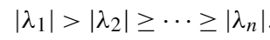
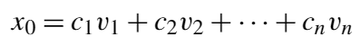

Power Method
Finding the largest eigenvalue
Sometimes, only require to find the largest dominant eigenvalue and its corresponding eigenvector.
Power method: iterative method that will converge to the largest eigenvalue
Let A be n x n matrix that has n real eigenvalues $λ$₁, $λ$₂, … $λ$_{n} and the corresponding linearly independent eigenvectors v₁, v₂, … v_{n}.
Since Eigenvalues are scalars, we can rank them as follows:
Eigenvectors: assumed to be linearly independent and they are a set of basis vectors → where c1 ≠ 0. If c1 = 0, we have to choose another initial vector to make c1 ≠ 0 true.

Slide 10
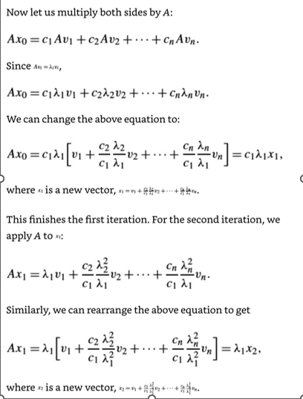
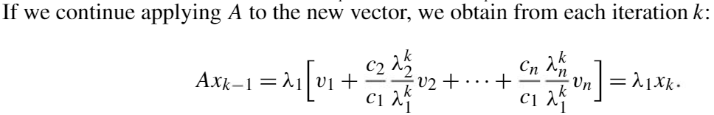

Power Method (cont.)
$λ$₁ is the largest eigenvalue → $λ$_{i/} $λ$₁ for all i>1 → for k sufficiently large, ($λ$_{k/} $λ$₁)^{k} will be close to 0.
Ax_{k-1} ~ $λ$₁ v₁ (all other factors in the equation can be neglected as k increases)

Slide 11
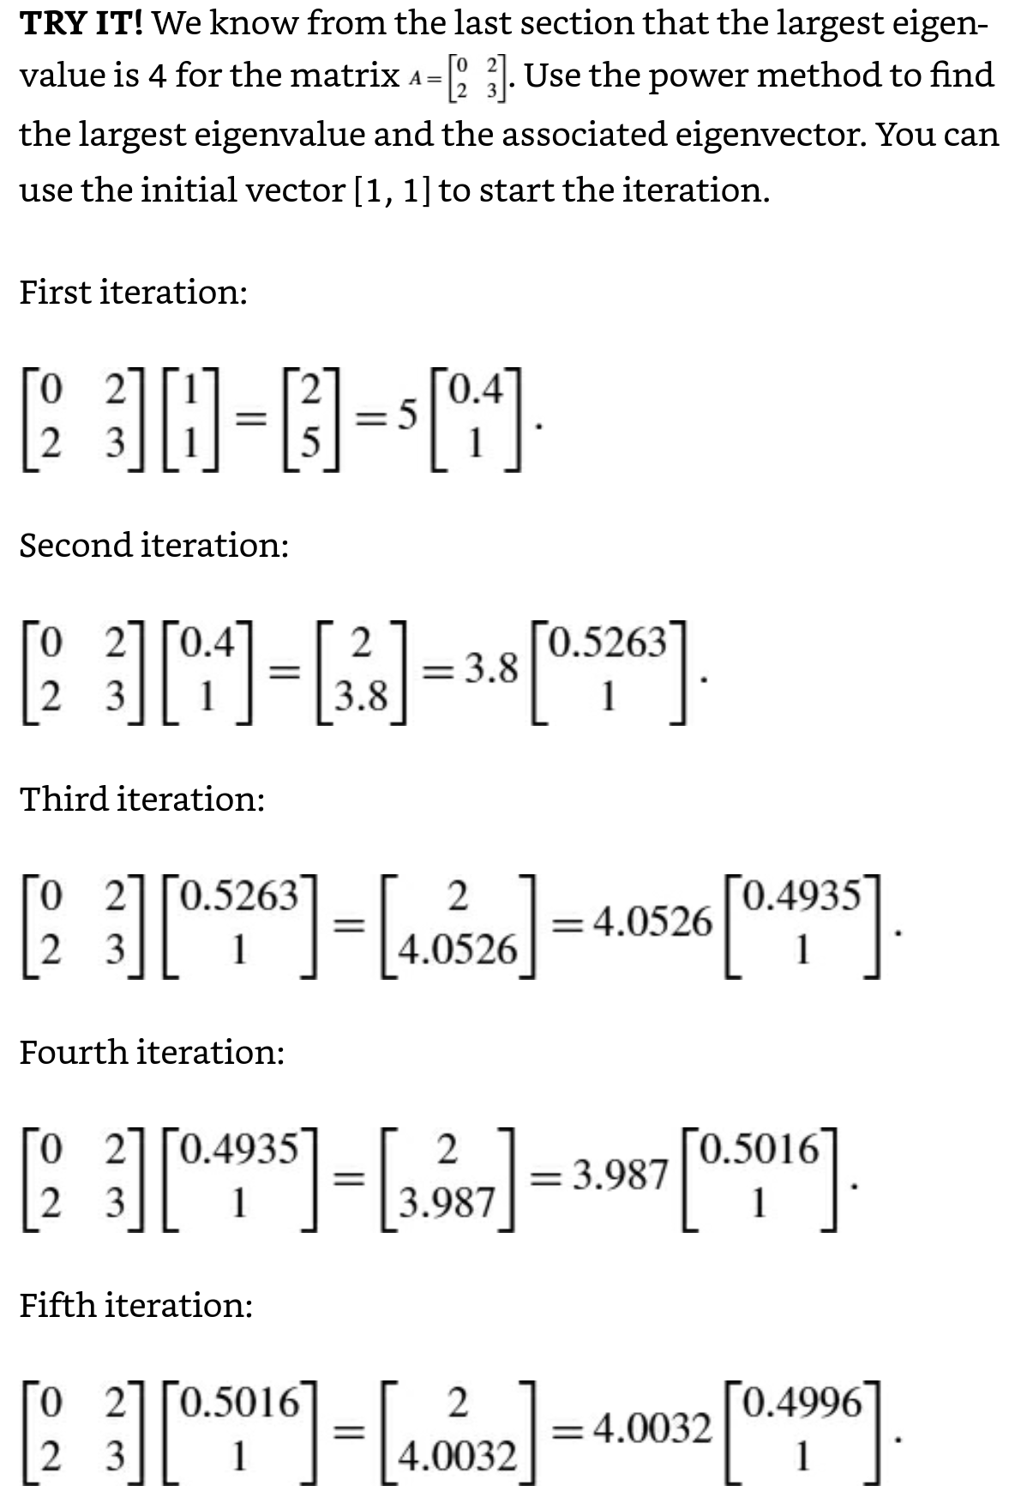
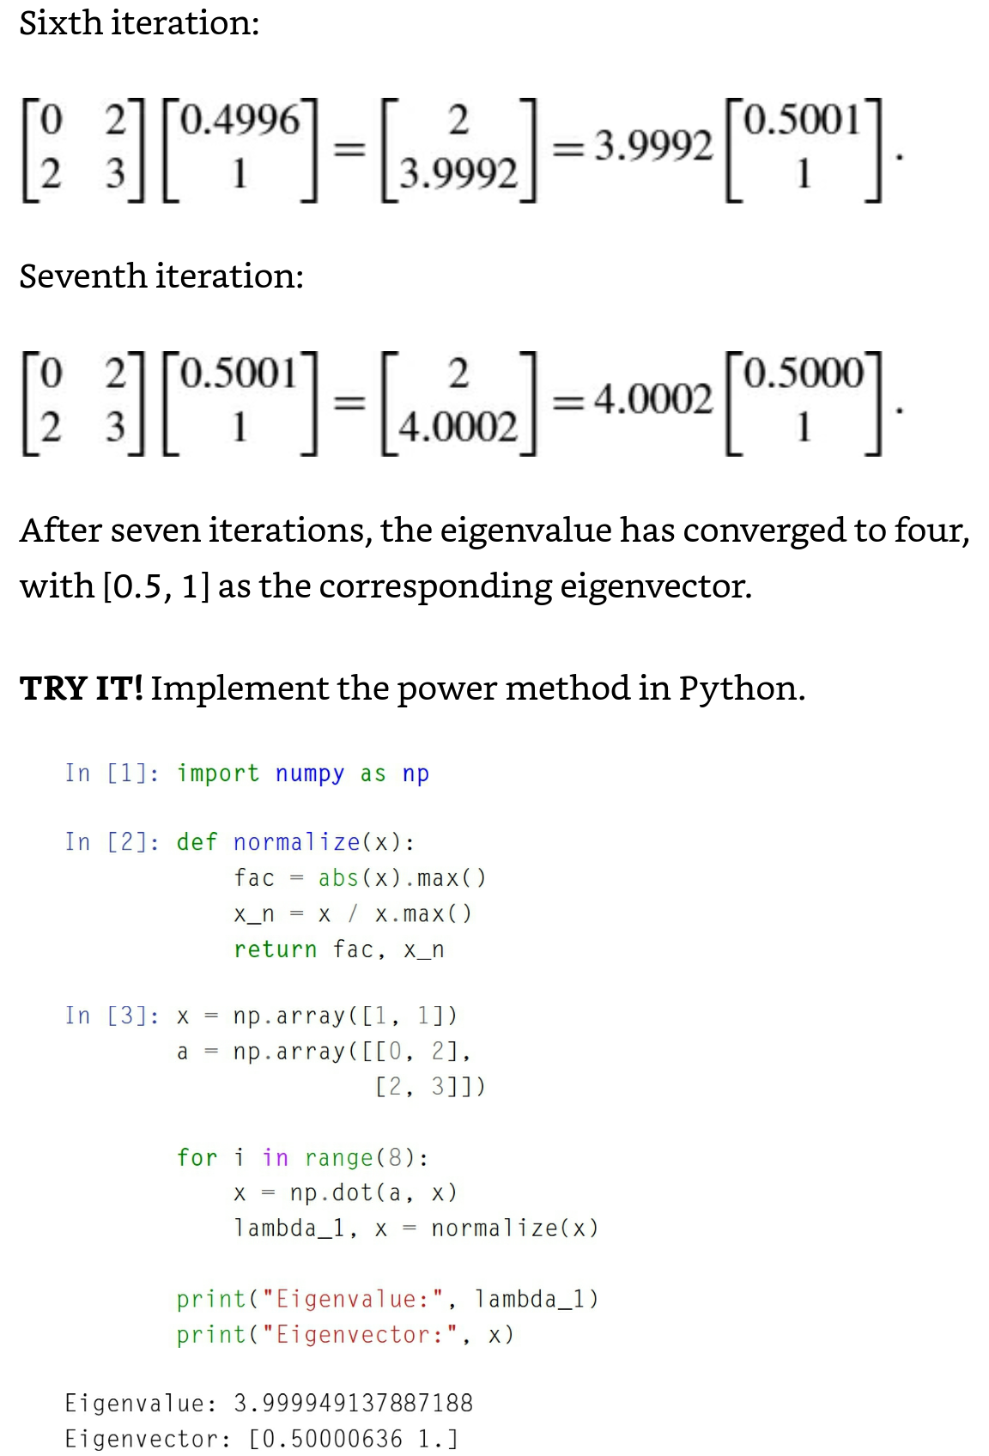
Example

Slide 12
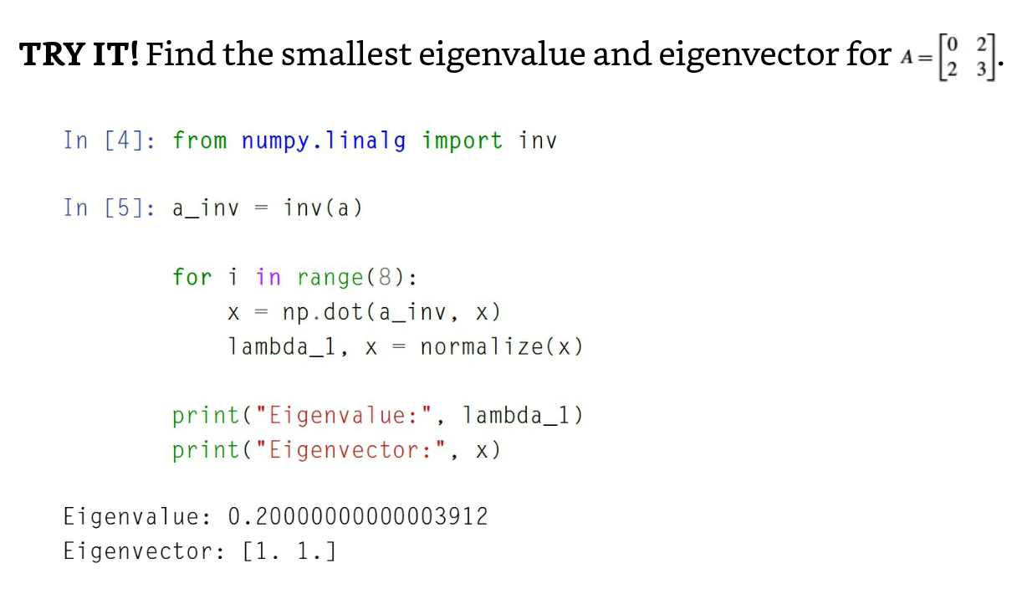

Inverse Power Method
Let A⁻¹ be an inverse of n x n matrix A
Use A⁻¹ instead of A
Now, find the smallest eigenvalue of A → using Inverse Power Method
Apply A⁻¹ for the iteration explained in the previous slides to find the largest value of 1/ $λ$₁ which will be the smallest value of the eigenvalues for A.

Slide 13
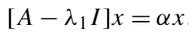

The Shifted Power Method
Sometimes, we want to find all eigenvalues and eigenvectors instead of just the largest and smallest.
Shifted Power Method: simple but inefficient way to do so.
The largest eigenvalue, $λ$₁, for Ax = $λ$₁x is obtained by the power method → where α’s are the eigenvalues of the shifted matrix A – $λ$₁I, which will be 0, $λ$₂- $λ$₁, $λ$₃- $λ$₁, …, $λ$_{n}- $λ$₁.
α_{k} = $λ$_{k}- $λ$₁ → the eigenvalue $λ$_{k} can be obtained.
Repeat this process to find all the other eigenvalues.

Slide 14
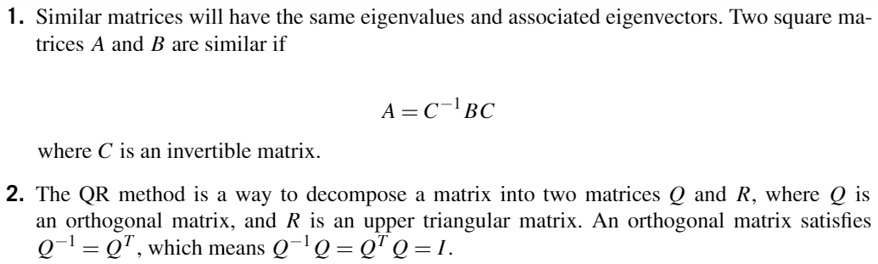
QR Method
Preferred iterative method to find all the eigenvalues of a matrix.
Based on two concepts

Slide 15
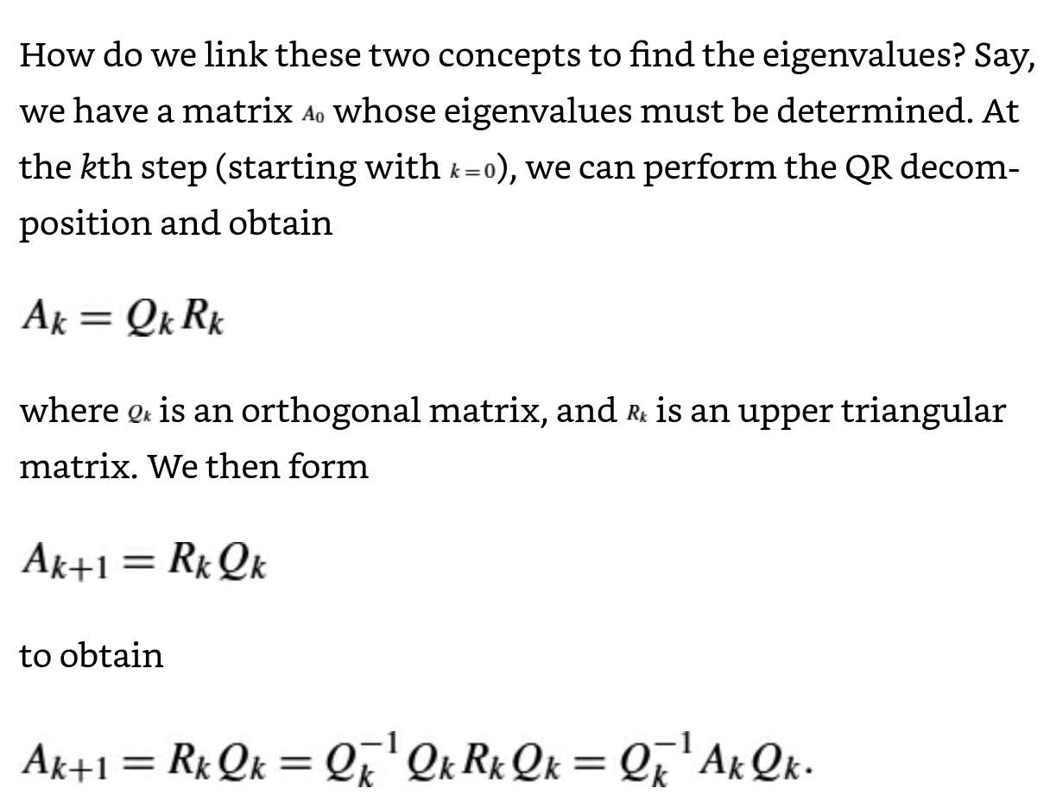
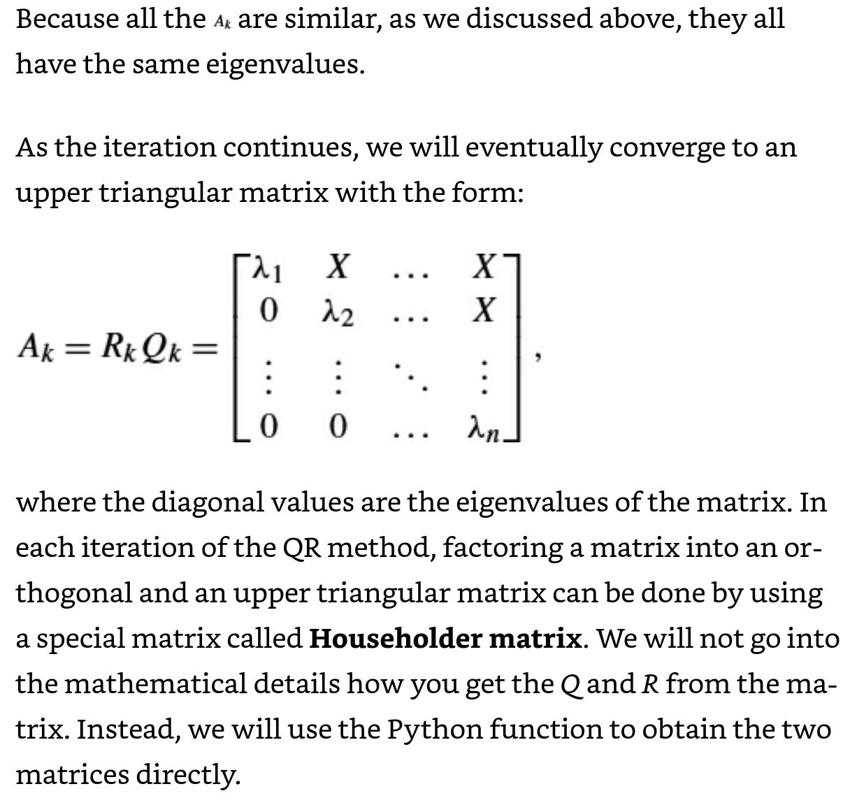
QR Method (cont.)

Slide 16

QR Method in Python

Slide 17
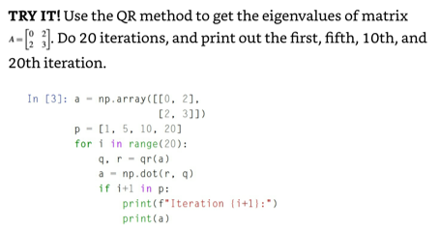
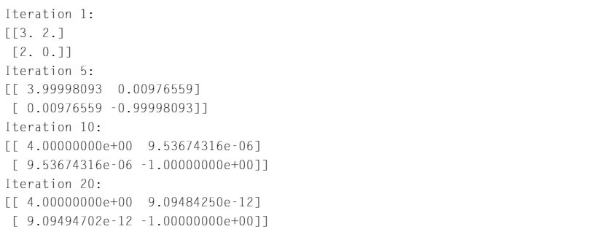
QR Method in Python (cont.)
Note that after the fifth iteration, the eigenvalues are converged to the correct ones.

Slide 18
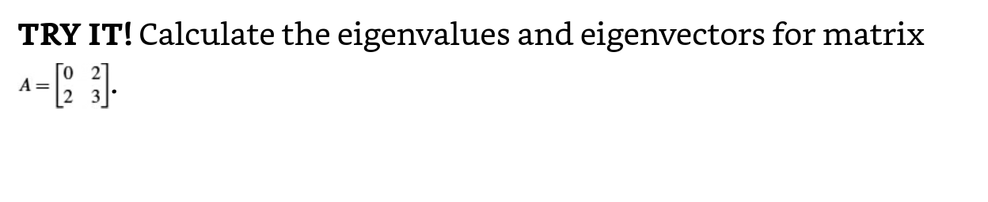
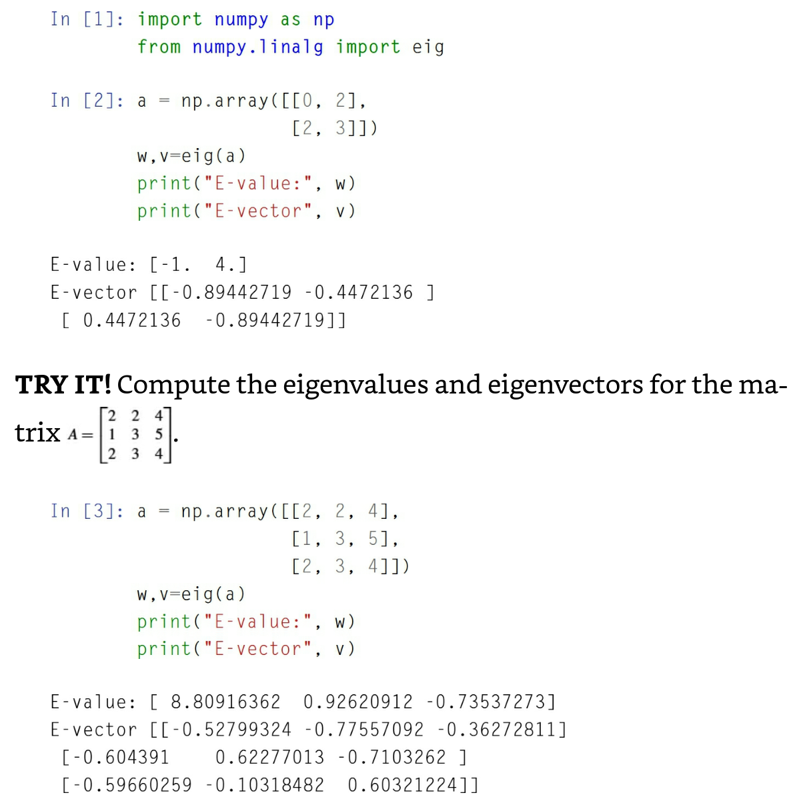
Eigenvalues and Eigenvectors in Python

